Slide 1
Introduction to Spreadsheets with Excel (for Humanities people)
Dr Heather Froehlich
University of Arizona Libraries
froehlich@arizona.edu

Slide 2
with thanks to
Data Carpentry https://datacarpentry.org/
Kelly Davis (for the meme on Slide 14)
Paige Morgan (for the Doctor Who dataset)
Joey Stanley (for slides 25-27)

Slide 3
For this workshop you will need to:
Open the SurvivoR sample dataset: https://bit.ly/3xj907t
→ this file is viewable and not editable in MS Office Online
File > Download a copy to your own computer.
Find and Open this .xlsx file with your own local of MS Excel.
→ you might need to log in using your university credentials when you first open Excel
And, just for fun: here’s the larger dataset (scroll to bottom for XLSX file)
http://gradientdescending.com/survivor-data-from-the-tv-series-in-r/

Slide 4
Spreadsheets are a highly structured way to present, manipulate, and store data

Slide 5
Where and why are spreadsheets?
You might encounter them when you are working with:
Metadata for a collection of items
Results of Qualtrics survey or other places where people provide input (e.g. crowdsourcing)
Budgets and other number-based activities
Designed to be computer-readable, not always human readable

Slide 6
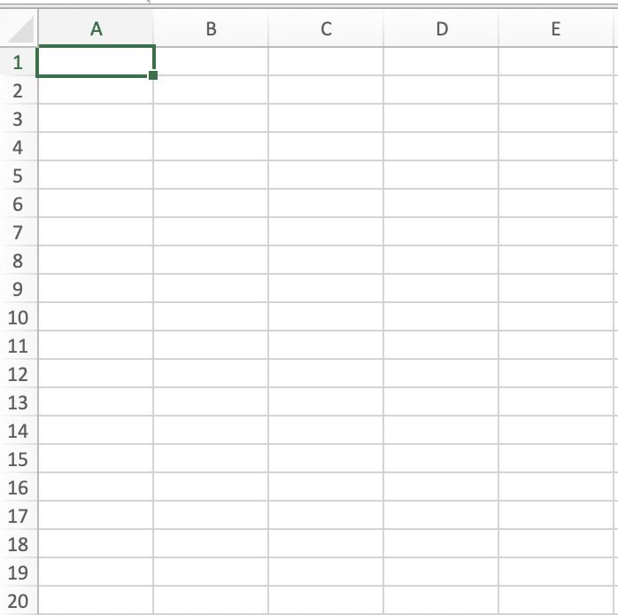
Data is stored in cells, columns and rows
Each box is a cell

Slide 7
Data is stored in cells, columns and rows
Each box is a cell
Each column represents a specific data feature (things you’re tracking)

Slide 8
Data is stored in cells, columns and rows
Each box is a cell
Each column represents a specific data feature (things you’re tracking)
Each row represents an individual item (observe features across table)

Slide 9
Data is stored in cells, columns and rows
Individual cells get names:
A3
D19
E7

Slide 10
You want to be able to see “across” your spreadsheet
Put all your variables in columns - the thing you’re measuring, like ‘weight’ or ‘temperature’
Put each observation in its own row
1 piece of information per cell
General rule: If you are cramming too many things into a column, time to make a new one!
Notes:
ONE EXCEPTION TO THIS GENERAL RULE IS METADATA NOTES but more on this later

Slide 11
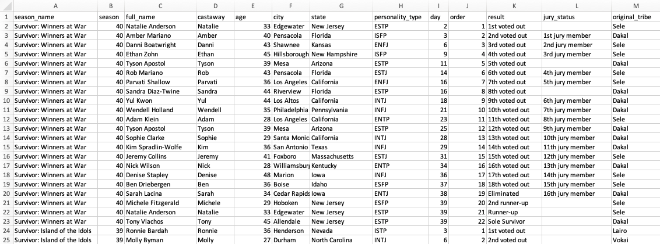
Find the value!
Notes:
LIKE BINGO
(call out some cell names and have the audience identify what they say for you)
e.g. G9, L3, H21, K6, C17, F3, etc.

Slide 12
What about these labels?
Notes:
What do these labels do for us? Why are they here?

Slide 13
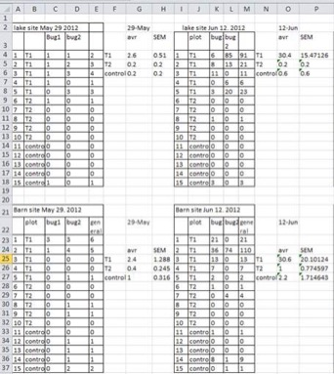
🚧 🚧 Multiple tables, one sheet 🚧 🚧
Notes:
Data Carpentry says THIS IS UNACCPETABLE, I say this looks like notes. I’ve compiled tables that look like this for my own purposes but they never see the light of day for someone else!
Problems: looks like tables connect (but don’t), aren’t fully aligned, floating stuff

Slide 14
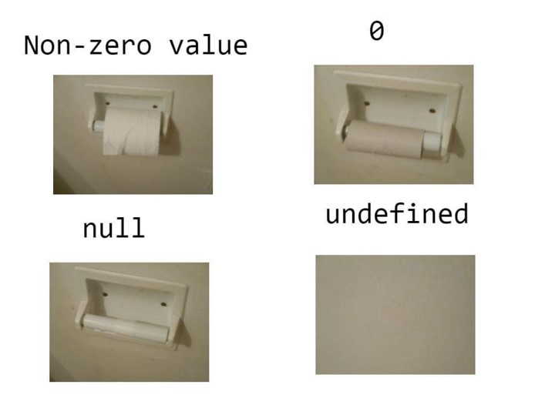
Different ways of recording a lack of information

Slide 15
Other things to remember
Using formatting (highlights, fonts etc) to convey specific information does not have meaning to Excel
Special symbols (+, -, #, !, @, *, etc) have meanings that you might not want (more on this to come)
Your spreadsheet is NOT a word doc (long commentary goes somewhere else)

Slide 16
Which columns in the SurvivoR dataset are related to each other?
Notes:
How are they related?

Slide 17
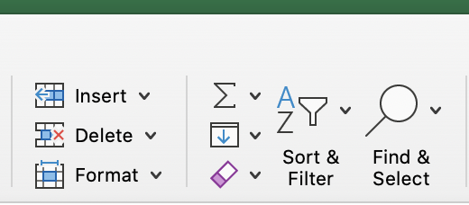
Relationships between data columns
Some data columns influence what happens with others
E.g. City, State (very linked)
Excel v good at helping you think about data in a range of different ways
“Sort and Filter”

Slide 18
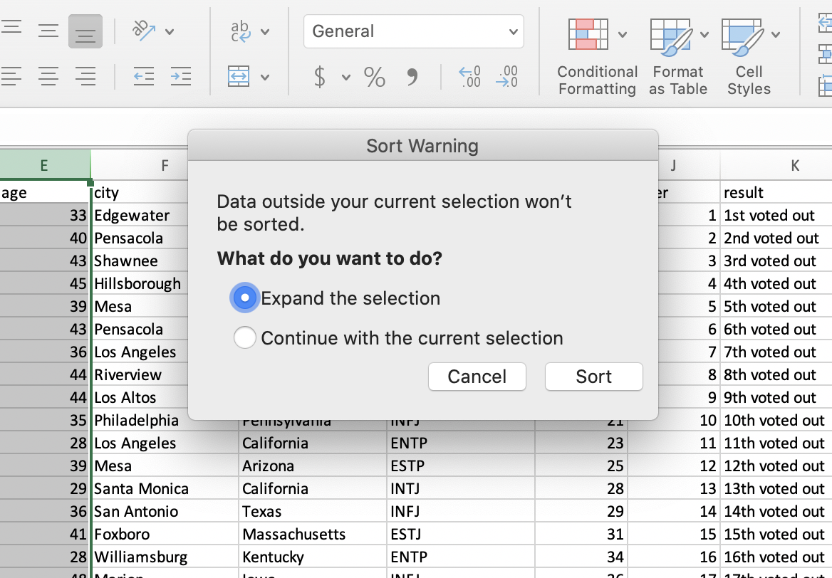
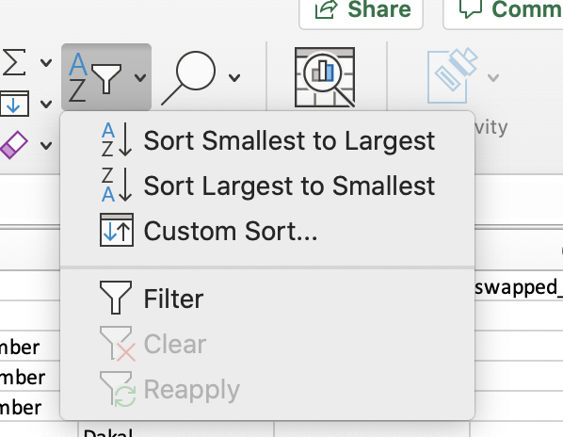
Select column E, “AGE”
What changes when you do this?

Slide 19
Data is inherently manipulatable
Sorting changes how we think about the data completely
Change your view for a different vantage point of the data
New associations what might not be as obvious!
Remember: Not everything is useful (but some things really are)
Now, do it yourself with another column from the SurvivoR data set.
What do you want to choose?
What changes when you sort it differently?
What does it tell you?

Slide 20
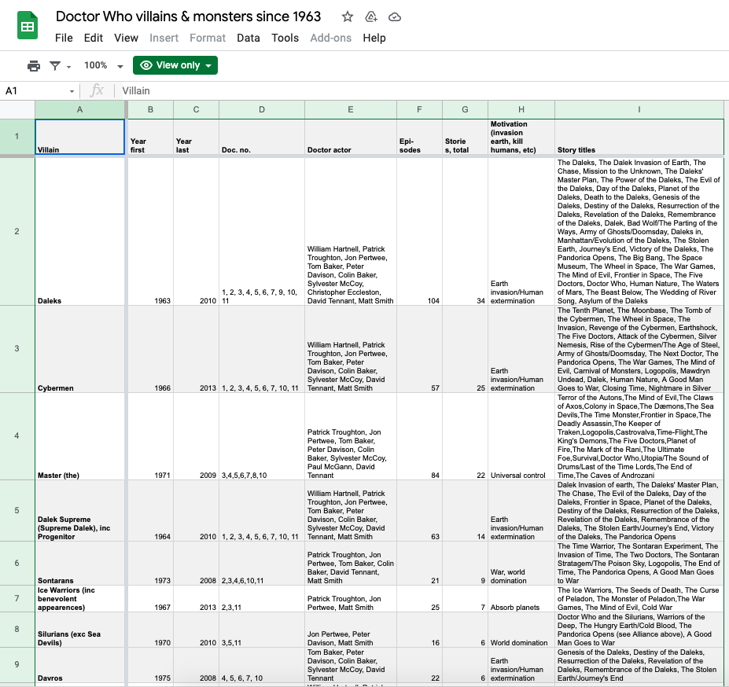
Assessment: What is wrong with
this table?
https://bit.ly/3vo21IU
How would we fix this?

Slide 21
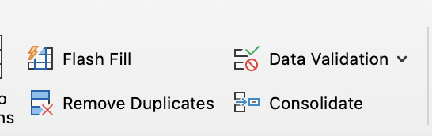
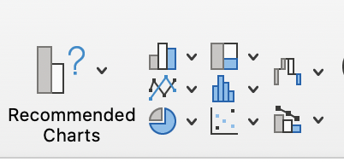
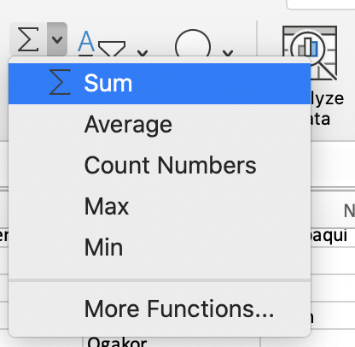
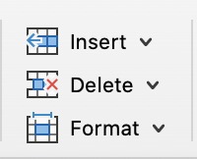
Other cool things Excel can do
Automatically calculate:
Sums (totals)
Average
Remove duplicates
(under DATA)
Make & Suggest Graphs
(under INSERT)
Add or delete a column or row

Slide 22
Why would we want to do these things?
Sums/Averages: | built in calculator!
Remove duplicates: | Did I accidentally record the same thing 2x?
Insert Column: | I want to add a column of more information
Insert Row: | I want to include a row of more information
Remove column/row: | I don’t need that after all
Make a graph: | I want to visualize the relationship between things

Slide 23
I want to move a column
Select the column to the RIGHT of where you want it to be
Between H and I: Select column H
Use the drop down menu on the right hand of the home screen:
INSERT > New Column. (or, right click and choose “INSERT”)
Where column H was, is now moved over to Column I. Column H now empty! New space created.
Select the column you want to move to Column H and copy-paste it into your empty column.
Don’t forget to clean up whatever you moved to Column H so there’s no duplication (highlight that column, right-click > delete)

Slide 24
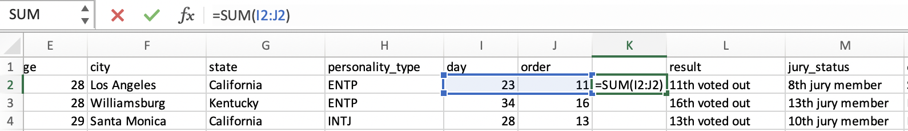
Putting it together: I want to add column I and J together
Make a new column (New column L)
Go to “Σ” (sigma) in the top right corner and choose “SUM”
Will autofill with available numeric data:
Hit enter. Will return the sum of 23 + 11 (= 34).
Notes:
Faster and automatic! And if you want to move around and collect different data you can do that
This particular spreadsheet not really well set up for this kind of math but you get the idea

Slide 25
I want to automagically compute other things
Click on an empty cell.
You can call up any numeric cell on the table with the little bar at the top of your spreadsheet just like we did on the previous slide
Begin your command with the equals sign:
= j2 * 100 | Multiply the value of J2 times 100
= j2 / k13 | Divide the value of J2 by the value of K13
= j1 + j2 + j3 +j4 + j5 | Add all the values of J1 through J5 together
= (j1 + j2) - k9 | Add J1 and J2 together and then subtract K9 from the sum of the Js
= (J1:J40) | Insert all values of column J into this column too

Slide 26
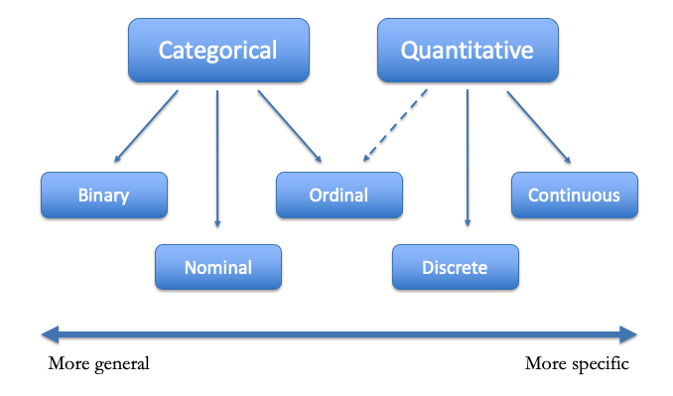
When creating data, think about what kinds of info you are generating
Notes:
Different kinds of data have different purposes

Slide 27
Thinking about different kinds of information
Categorical
Quantitative
Example: height
binary: short/tall
ordinal: short, average, tall
discrete: feet and inches
continuous: centimeters
Binary
Ordinal
Continuous
Nominal
Discrete
More general
More specific
16

Slide 28
Kind of data | How you might find this in the wild
BINARY DATA (a or b) | Yes / No Male / Female Latin / Dutch
ORDINAL DATA (word-based; descriptive) | Yes / No / Maybe Latin / Dutch / Spanish / French Responses to surveys
DISCRETE DATA (assigning whole numbers to represent different meanings) | anything with counting / frequency number of times a word occurs in a text number of transactions between two groups
CONTINOUS DATA (any numerical data on a continuous scale) | Assigning a % score (0 = never; 1 = always) Dates (time between events) Coordinates
Notes:
And these are all MIX AND MATCH – you can put these all next to each other

Slide 29
Things to think about when we work with data:
Who do we want to use this data when we’re done with it?
What choices do we make when we make data look a certain way?
What do people need to know about the data in order to work with it effectively?
What associations within the data set are meaningful? Why?

Slide 30
Finally, visualizing the data
Graphs visualize correlations between multiple columns
Correlation ≠ causation, however!
Prefers number-based (numerical) data
Notes:
We’re not going to spend a ton of time on this other than to say that this is in some ways a very main feature of Excel that people often like

Slide 31
Different kinds of charts have different utilities
Pie charts are good for working with % of a whole
Bar graphs are good for showing variation for one variable across multiple data sources
Scatterplots are good for relationships across several variables
Notes:
Different charts have different purposes and reasons for existing; not a 1- size fits all situation

Slide 32
In conclusion – spreadsheets help us
Store and organize our data in a highly structured way
Manipulate our data to think about it in a variety of different ways
Develop meaningful associations between individual aspects of our data

